Slide 1
Gym Website
Industrial Training

Slide 2
Introduction
In this training, I learnt about Programming with HTML and CSS, PHP.
I implemented a Gym Website with HTML, CSS and PHP.
The basic concept of this Gym Website is to provide a system which handles the information of the people who visited to my website and looking for joining Gym. It even maintains the data of customer as like name, age, Gender, Contact,Email and Address. So that we can easily provide him/her to join gym as soon as possible.Data will be stored in the database.

Slide 3
When you enter the website, they will see all detail of Our Gym Company services. If you feel best gym company , then you can fill the details as soon as possible without wasteing time.In order to fill the details, the user will have to enter his/her name, contact number,location,age and Gender. .If you having any kind of problem regarding services and any kind of problem then contact us.

Slide 4

Language Used
Html
Hypertext Markup Language (HTML) is the standard markup language for documents designed to be displayed in a web browser. HTML elements are delineated by tags, written using angle brackets.
Language designers: WHATWG
Inventor: Tim Berners-Lee
Developers: World Wide Web Consortium, WH...

Slide 5

Css
CSS stands for Cascading Style Sheets
CSS describes how HTML elements are to be displayed on screen, paper, or in other media
CSS saves a lot of work. It can control the layout of multiple web pages all at once
External stylesheets are stored in CSS files

Slide 6

PHP
PHP files can contain text, HTML, CSS, JavaScript, and PHP code
PHP code is executed on the server, and the result is returned to the browser as plain HTML
PHP files have extension ".php"
PHP is a widely-used, open source scripting language
PHP scripts are executed on the server

Slide 7
Hardware Requirements:
I3 processor based computer
4GB RAM (minimum)
5 GB hard disk space
Software Requirements:
Windows10
Visual studio code
Intellij
Google Chrome

Slide 8
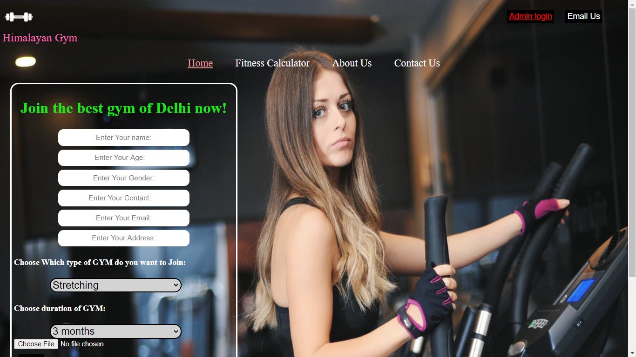
Homepage of Website

Slide 9
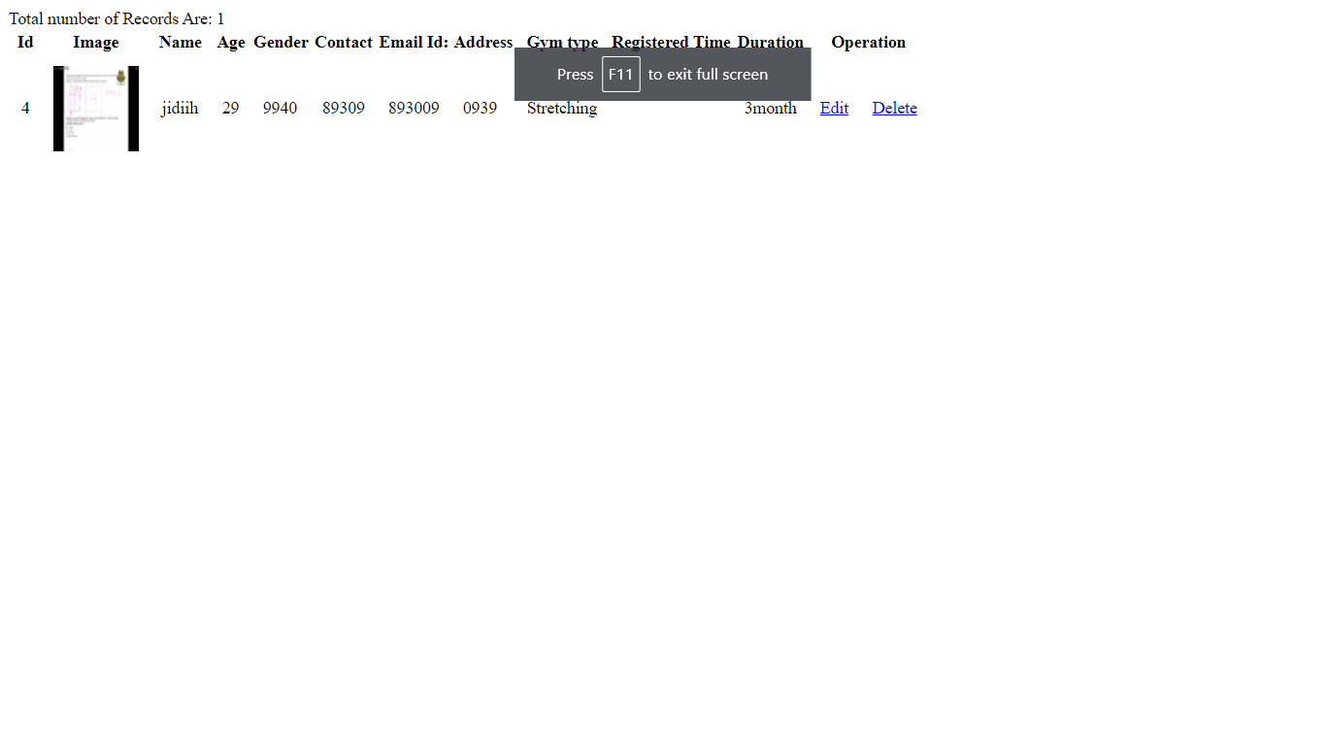
Admin Panel

Slide 10
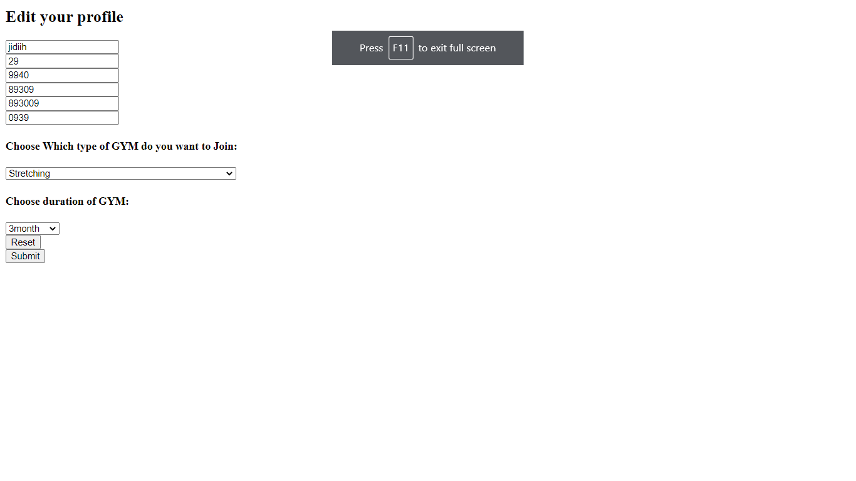
Update Client Panel

Slide 11
Link of my Project
GymWebsite
Link on Github
Gymwebsite

